Slide 1
SQL Relationships
One to one, one to many and many to many

Slide 2
What is SQL relationships?
SQL relationships refer to the different types of connections that can be established between tables in a relational database. The main types of SQL relationships are:

Slide 3
1. One-to-One (1:1): In this relationship, one row in a table is associated with one and only one row in another table, and vice versa. This is a relatively rare relationship type, but it can be useful for separating data into two tables for performance or normalization reasons.

Slide 4
2. One-to-Many (1:M): In this relationship, one row in a table can be associated with multiple rows in another table, but each row in the "many" table is associated with only one row in the "one" table. This is one of the most common relationship types, for example, a customer can have multiple orders, but each order belongs to only one customer.

Slide 5
3. Many-to-Many (M:N): In this relationship, multiple rows in a table can be associated with multiple rows in another table. To implement this relationship, you typically need a junction or associative table that connects the two main tables.

Slide 6
These relationships are established using foreign keys, which are columns in one table that reference the primary key column in another table. The foreign key column in the "many" table (or the "child" table) links it to the "one" table (or the "parent" table).

Slide 7
Here's an example of how these relationships might look in a simple database schema:

Slide 8
- One-to-One: A person has one and only one social security number, and a social security number belongs to one and only one person.

Slide 9
- One-to-Many: A customer can have multiple orders, but each order belongs to only one customer.

Slide 10
- Many-to-Many: A student can be enrolled in multiple courses, and a course can have multiple students enrolled in it. The junction table would be something like "student_course" that connects the students and courses tables.

Slide 11
Understanding SQL relationships is essential for designing efficient and normalized database schemas, as well as for writing complex queries that involve joining tables based on these relationships.

Slide 12
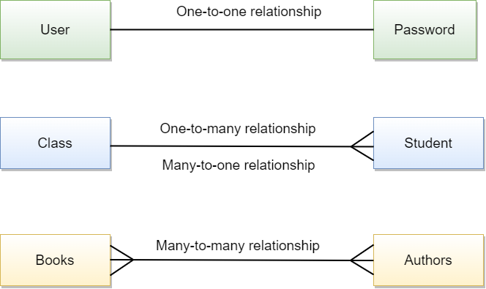
Example

Slide 13
Cardinality in DBMS
The cardinality is important because it helps us understand how the two boxes (or tables) are connected and how we can move things between them. It's like a special rule that tells us how to play with the boxes and the things inside them.

Slide 14
Now, let's talk about the three different types of cardinality:
1. One-to-One (1:1): This means that for every single thing you put in the "Table A" box, there is only one matching thing you can put in the "Table B" box. It's like having two socks that always go together, you can't have one sock without the other.

Slide 15
2. One-to-Many (1:M): This means that for every single thing you put in the "Table A" box, you can put lots of things in the "Table B" box. It's like having one family, and the family has many children. Each child belongs to only one family, but one family can have many children.

Slide 16
3. Many-to-Many (M:N): This means that for every single thing you put in the "Table A" box, you can put lots of things in the "Table B" box, and for every single thing you put in the "Table B" box, you can put lots of things in the "Table A" box. It's like having a group of friends and a group of hobbies, where each friend can have many hobbies, and each hobby can have many friends who enjoy it.

Slide 17
Why do we create third table in M:N?
You have two groups of things - authors and books. And some authors can write more than one book, and some books can be written by more than one author.
So, we need a special table to keep track of which authors wrote which books. This special table is called the `author_books` table.

Slide 18
The `author_books` table is like a bridge that connects the authors and the books. It helps us remember which author wrote which book.
And if we want to know something special about the author and the book, like when the book was published, we can add that information to the `author_books` table.

